Slide 1

“Watchful Eye: Enhancing Security through License Plate Recognition Technology using Python Programming”
G PAVAN KUMAR (192210610)
Y SANTHSOH (192111696)
JAKATHISH S (192221007)

Slide 2
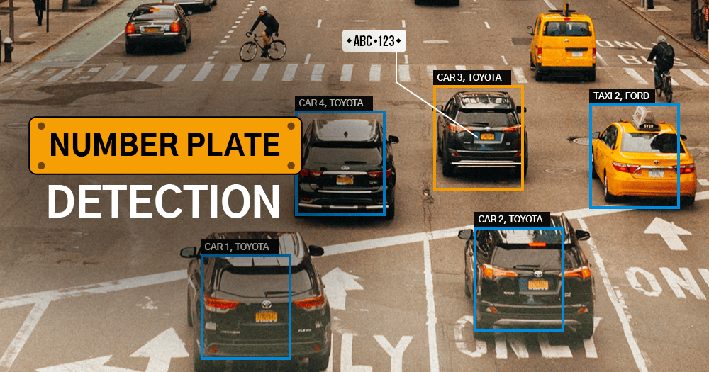
Abstract
Objective and Scope: Introduction to Number Plate Recognition (NPR) as a computer vision technology. Overview of its applications in law enforcement, traffic management, and vehicle tracking.
System Components and Stages: Description of stages: data acquisition, pre-processing, plate localization, and character extraction. Emphasis on the role of machine learning, particularly CNNs, in plate detection and recognition.
Challenges and Ongoing Research: Recognition of challenges like lighting variations and diverse plate formats. Mention of ongoing research focusing on developing robust algorithms for wider applicability.
Conclusion: NPR systems as powerful and essential tools for modern transportation and security. Acknowledgment of continuous improvement through advancements in computer vision, machine learning, and OCR technologies.

Slide 3
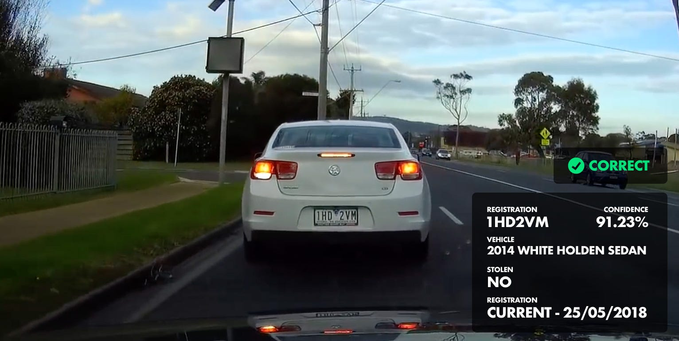
Introduction
Introduction to NPR Technology: Number Plate Recognition (NPR) is a cutting-edge technology designed to automate the identification and interpretation of vehicle license plates.
Versatility Across Applications: NPR finds widespread applications in diverse sectors such as law enforcement, traffic management, access control, and surveillance, showcasing its adaptability and relevance in modern society.
Key Role in Efficiency and Security: Positioned at the forefront of technological advancements, NPR plays a pivotal role in enhancing operational efficiency and security, particularly in tasks like toll collection, parking management, and law enforcement.
Transformative Impact: As technology continues to evolve, NPR stands as a transformative force, offering a sophisticated solution that aligns with the growing demand for efficient, automated, and secure processes in various domains.
This Photo by Unknown Author is licensed under CC BY

Slide 4
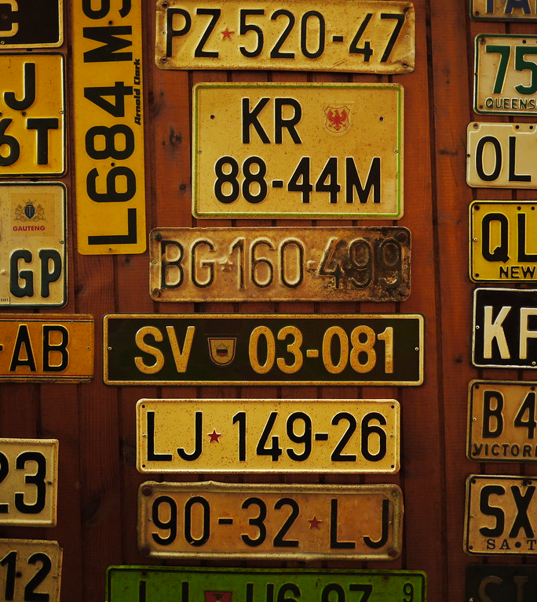
Best Studies
These systems use optical character recognition ( OCR ) software to isolate and identify vehicle registration details. This technology is typically utilized for automatic toll collection, or to detect speeding violations, but can also be used to monitor vehicle movement and for access control.
The SSD algorithm is used to detect objects and segment images, i.e., locate license plates in images using a single deep neural network. It is a technique to create a bounding box (an area) for each segment within an image, allowing exact object detection and segmentation.
This Photo by Unknown Author is licensed under CC BY-SA

Slide 5
Literature Survey
Summarize key findings and trends from previous research studies related to NPR
Discuss any challenges or limitations identified in the literature, such as issues with accuracy, privacy concerns, or technological constraints
Identify gaps in current research that need further investigation, paving the way for the audience to understand where future research efforts could be directed

Slide 6
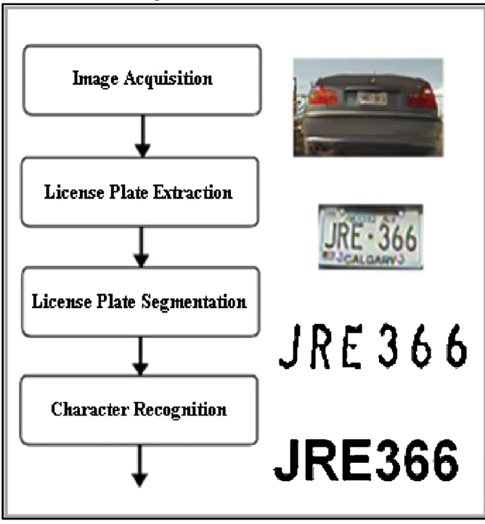
Steps Involved
Capture Data: Use cameras and sensors to take pictures of vehicles. Optical sensors gather initial information.
Clean Up Images: Remove unnecessary details and errors. Adjust brightness for consistent quality.
Find License Plates: Identify plate borders using edges. Look for potential plates using shapes and templates.
Read Characters: Extract letters and numbers using OCR. Use CNNs for better pattern recognition.
Refine Information: Correct any mistakes in character recognition. Double-check and improve accuracy

Slide 7
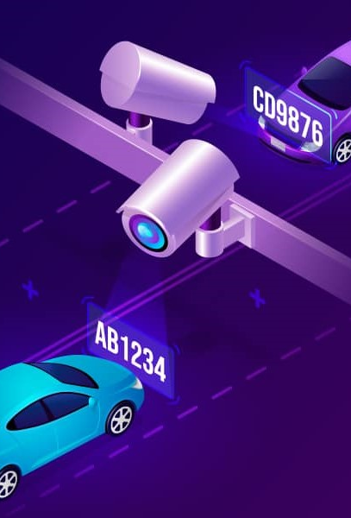
Advantages
Efficiency and Automation: NPR systems automate license plate capture and interpretation, streamlining tasks like toll collection and parking management. This enhances operational efficiency by reducing manual efforts and processing times.
Enhanced Security: In law enforcement and access control, NPR quickly identifies and tracks vehicles, bolstering security measures.
Traffic Management Optimization: NPR systems facilitate traffic flow analysis, enabling better congestion management and overall traffic control.
Time and Cost Savings: Automation in tasks such as toll collection and parking management results in significant time and cost savings.

Slide 8
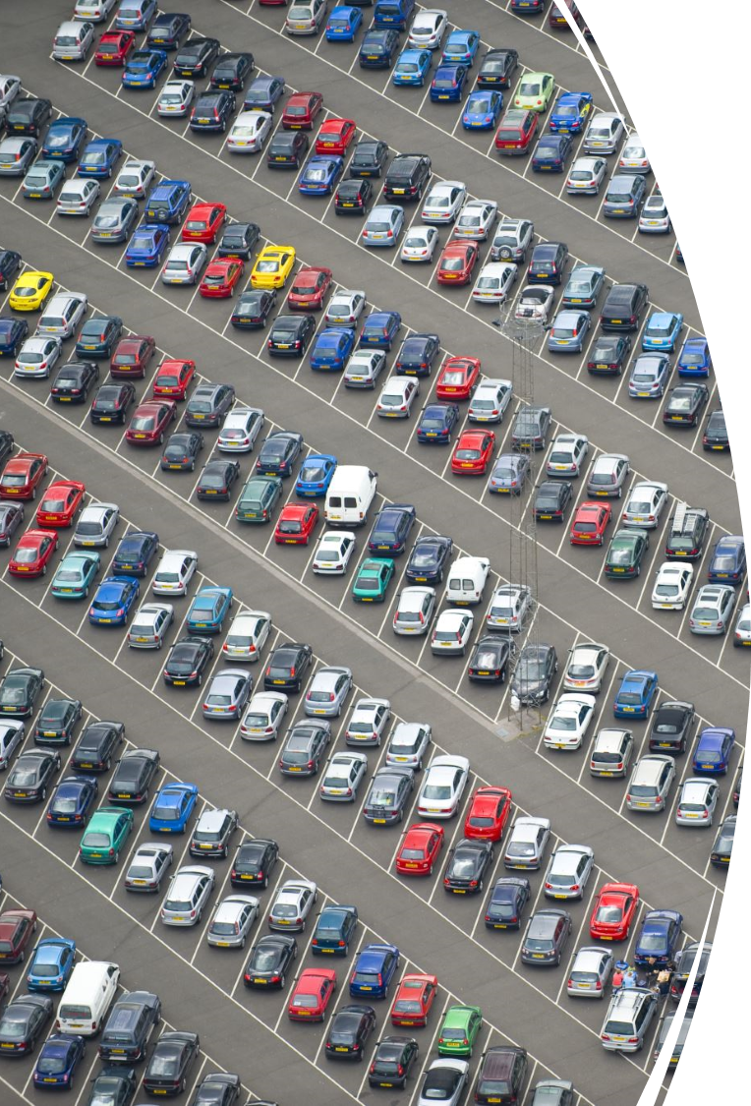
Disadvantages
Accuracy Challenges: Number Plate Recognition (NPR) systems may face difficulties in accurately capturing plates under varying lighting conditions and diverse plate formats, leading to potential errors in identification.
Privacy Concerns: The widespread use of NPR raises privacy concerns as it involves constant monitoring and recording of license plates, potentially infringing on individuals' privacy rights and invoking surveillance apprehensions.
High Initial Costs: Implementing NPR systems can require significant initial investments in hardware, software, and infrastructure, making it financially challenging for some organizations or regions to adopt this technology.
Dependency on Technology: NPR systems are susceptible to technical failures, and their effectiveness heavily relies on the proper functioning of cameras, sensors, and software. System malfunctions or glitches may compromise their reliability.

Slide 9
CODING
import tensorflow as tf
from tensorflow import keras
from keras import layers, models
from keras.preprocessing.image import ImageDataGenerator
from keras.models import load_model
import cv2
import pytesseract
import numpy as np
import imutils
train_path = 'license_plates/train'
test_path = 'license_plates/test'
img_height, img_width = 128, 128
batch_size = 32
train_datagen = ImageDataGenerator(
rescale=1./255,
rotation_range=20,
width_shift_range=0.2,
height_shift_range=0.2,
shear_range=0.2,
zoom_range=0.2,
horizontal_flip=True,
fill_mode='nearest'
)
test_datagen = ImageDataGenerator(rescale=1./255)
train_generator = train_datagen.flow_from_directory('license_plates/train', target_size=(img_height, img_width), batch_size=batch_size, class_mode='binary')
test_generator = test_datagen.flow_from_directory('license_plates/test', target_size=(img_height, img_width), batch_size=batch_size, class_mode='binary')
model = models.Sequential([
layers.Conv2D(32, (3, 3), activation='relu', input_shape=(img_height, img_width, 3)),
layers.MaxPooling2D((2, 2)),
layers.Conv2D(64, (3, 3), activation='relu'),
layers.MaxPooling2D((2, 2)),
layers.Flatten(),

Slide 10
CODING
layers.Dense(128, activation='relu'),
layers.Dense(1, activation='sigmoid')
])
model.compile(optimizer='adam', loss='binary_crossentropy', metrics=['accuracy'])
history = model.fit(train_generator, epochs=10, validation_data=test_generator)
test_loss, test_acc = model.evaluate(test_generator)
print(f"Test Accuracy: {test_acc}")
model.save('license_plate_recognition_cnn_model.h5')
loaded_model = load_model('license_plate_recognition_cnn_model.h5')
image = cv2.imread('MH12DE1433.jpg')
image = imutils.resize(image, width=500)
cv2.imshow("Original Image", image)
gray = cv2.cvtColor(image, cv2.COLOR_BGR2GRAY)
gray = cv2.bilateralFilter(gray, 11, 17, 17)
edged = cv2.Canny(gray, 170, 200)
cnts, _ = cv2.findContours(edged.copy(), cv2.RETR_LIST, cv2.CHAIN_APPROX_SIMPLE)
cnts = sorted(cnts, key=cv2.contourArea, reverse=True)[:30]
NumberPlateCnt = None
for c in cnts:
peri = cv2.arcLength(c, True)
approx = cv2.approxPolyDP(c, 0.02 * peri, True)
if len(approx) == 4:
NumberPlateCnt = approx
break
mask = np.zeros(gray.shape, np.uint8)
new_image = cv2.drawContours(mask, [NumberPlateCnt], 0, 255, -1)
new_image = cv2.bitwise_and(image, image, mask=mask)
config = ('-l eng --oem 1 --psm 3')
text = pytesseract.image_to_string(new_image, config=config)
print(f"Recognized Text: {text}")

Slide 11
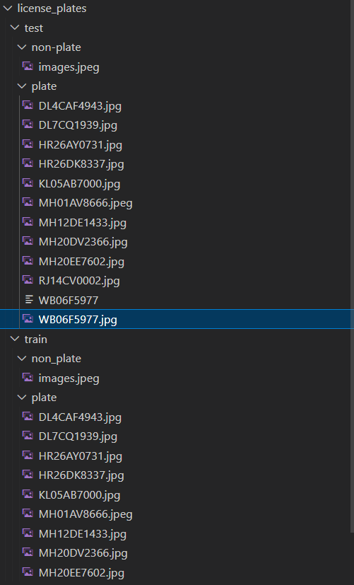
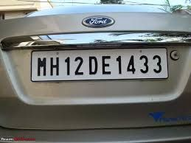
INPUT DATASET
INPUT IMAGE
DATASET MAGES

Slide 12
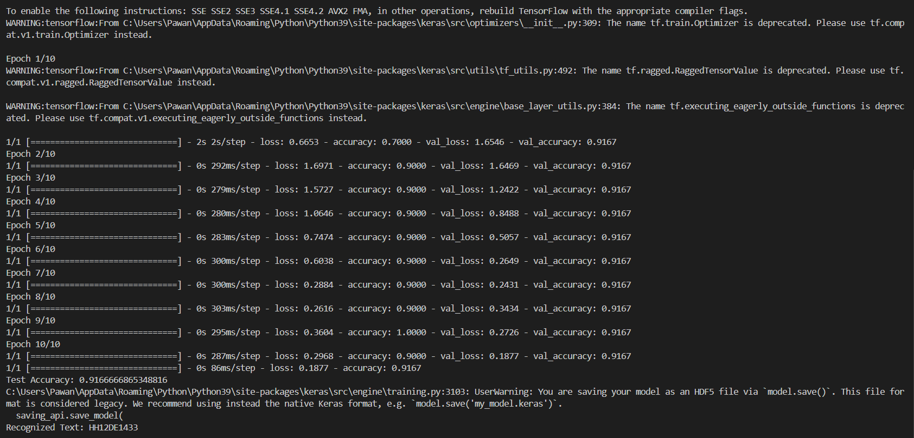
OUTPUT
TEST ACCURACY : 91.66%
RECOGNIZED TEXT : HH12DE1433

Slide 13

Results:
Showcase data on the performance of NPR systems in real-world applications, highlighting successful outcomes achieved through NPR implementation
Discuss any challenges or unexpected results encountered during NPR implementation, providing insights into the practical considerations of deploying NPR systems
Use visuals such as graphs, charts, or tables to illustrate the results effectively and make them more accessible to the audience

Slide 14
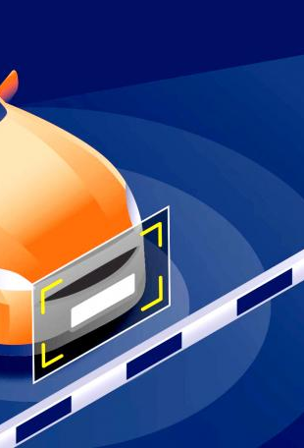
Future Directions
Advanced Deep Learning Models: Improve accuracy through the development of more sophisticated CNNs and deep learning architectures for robust plate detection and character recognition.
Privacy-Preserving Techniques: Implement methods to address privacy concerns, ensuring compliance by anonymizing or encrypting license plate data.
Real-Time Analytics and Decision-Making: Enhance real-time analytics capabilities to enable quicker decision-making in applications like traffic management and law enforcement.
Geographical and Environmental Adaptability: Develop NPR systems capable of adapting to diverse geographical regions, distinct license plate designs, and challenging environmental conditions for broader applicability.

Slide 15

Conclusion
Continued Technological Advancements: The ongoing evolution of Number Plate Recognition (NPR) technology promises continuous improvements in accuracy and efficiency, driven by advancements in deep learning and computer vision.
Balancing Innovation with Privacy: As NPR systems progress, there is a critical need to strike a balance between technological innovation and privacy considerations. Implementing robust privacy-preserving techniques ensures responsible and ethical use.
Widespread Applicability and Integration: The versatility of NPR systems makes them integral to various sectors, from law enforcement to smart city initiatives. Integrating these systems seamlessly into broader urban infrastructure enhances overall safety and efficiency.
Future Focus on Adaptability and Sustainability: The future of NPR lies in its adaptability to different environments, geographic variations, and sustainable implementations. Ongoing research and development will pave the way for NPR systems that are not only accurate but also environmentally conscious and globally applicable.

Slide 16


